Slide 1

CS 533 INTRO TO DATA SCIENCE
Michael Ekstrand

Slide 2
REPRODUCIBLE PIPELINES

Slide 3

Learning Outcomes
Understand the value of a reproducible pipeline for both science and industrial application.
Know where to read more about tools to help build and automate them.
Photo by Anne Nygård on Unsplash

Slide 4
Reproducibility
Cornerstone of current scientific philosophy
A result only observable once is unlikely to be valid (or at least useful)
Need to re-run with new data
Update forecasts / models for the next month
Check for bugs and sensitivity
End-to-end re-run catches order-of-operations bugs
Re-running with new random seed(s) checks for seed-sensitivity
Helps ensure you actually did what you say you did

Slide 5
Goal
Rerun the entire analysis end-to-end with a single command
Well-documented set of steps acceptable alternative
Possibly with new:
Data
Software versions
Settings

Slide 6
Requirements
What steps need to happen?
What scripts or notebooks?
What arguments?
What order do they need to happen in?
Optional: Is a step up-to-date?
Only recompute out-of-date steps
Saves time, energy, money
Sounds like make?

Slide 7
Data Version Control (dvc)
Pipeline has stages, with:
Input files
Output files
Command to produce outputs from inputs
Stages defined in DVC files committed to Git
Output-only stage just records the presence of a file

Slide 8
DVC – Reproduce Stage(s)
Checks if it’s up-to-date
Inputs, outputs, command match last recorded run
Re-runs command if out of date
Recursively updates dependencies first
Like Make, but uses checksums instead of mtimes
Commits checksums to Git
Reproduce entire pipeline by ensuring final stage(s) are current

Slide 9
DVC – Manage Data
DVC also manages data
Stage files contain input/output checksums
Git ignores all outputs
DVC copies outputs to/from data server (e.g. Amazon S3)
Easy to insure you have the current copy of the data

Slide 10
DVC in Practice
Entire pipeline in DVC
Experiment with manual commands
Save to DVC once I have the run figured out
Run expensive models on university cluster
Push results to data server
Pull to other machine for final analysis with notebooks
Easy to make sure we have current data (just as with Git)

Slide 11
Other Tools
MLflow
Make
Gradle (useful for Java-based environments)
Many others.

Slide 12
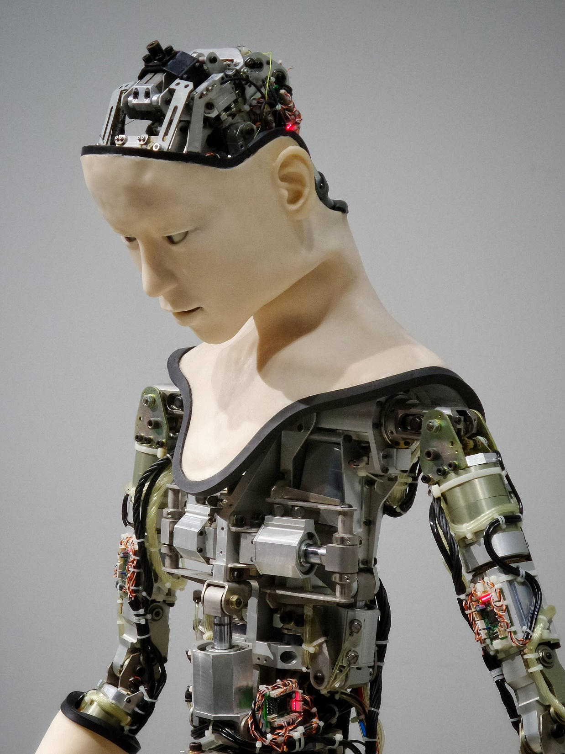
Wrapping Up
Fully reproducible data science pipelines help science and practice.
Tools such as dvc can help you build them.
Photo by Possessed Photography on Unsplash

